Slide 1


Summary of Earthquake Stuff Data from SCEC
KetilH, 31. July 2014

Slide 2
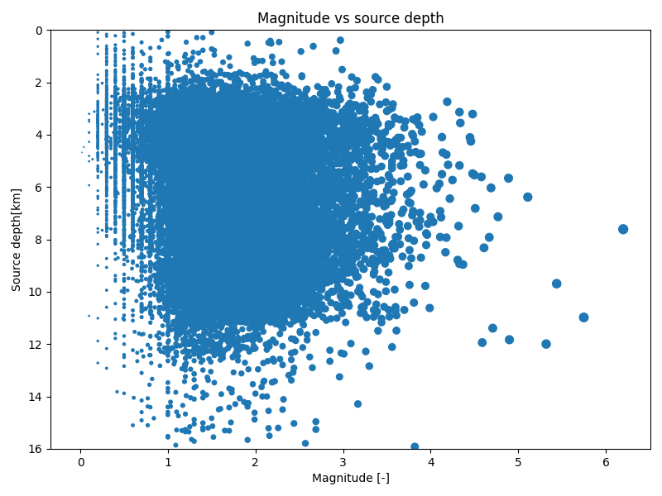
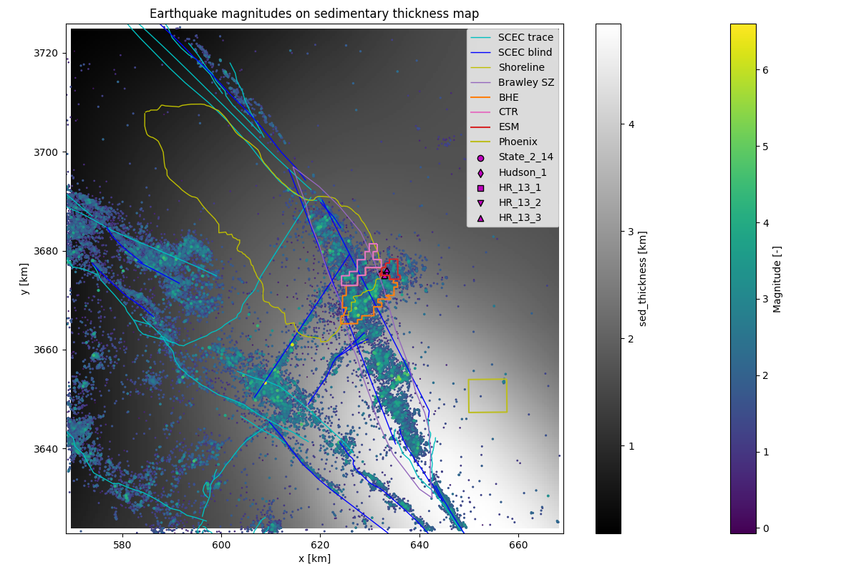
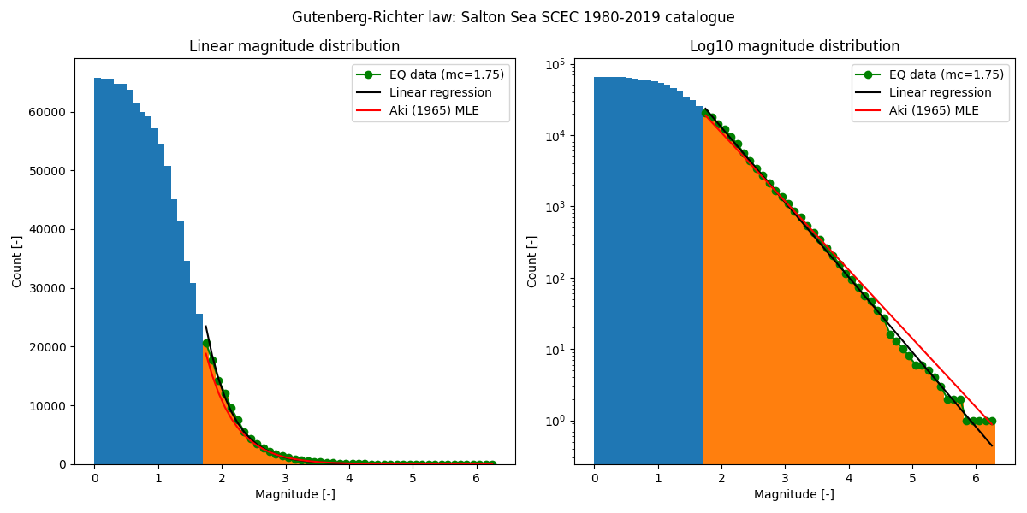
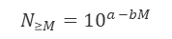
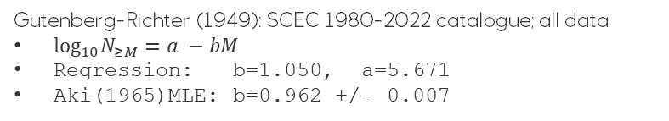
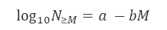
Earthquakes (SCEC 1980-2019) Natural and induced seismicity
Shallow cluster: Earth quakes in sediments and metasediments
Large earthquakes (M>5) occur mainly in the deeper cluster
Deeper cluster: Earth quakes in the crust
$$N_{≥M}={10}^{a −bM}$$
$$log_{10}N_{≥M}=a −bM$$
Gutenberg-Richter (1949): SCEC 1980-2022 catalogue; all data
$log_{10}N_{≥M}=a −bM$
Regression: b=1.050, a=5.671
Aki(1965)MLE: b=0.962 +/- 0.007

Slide 3
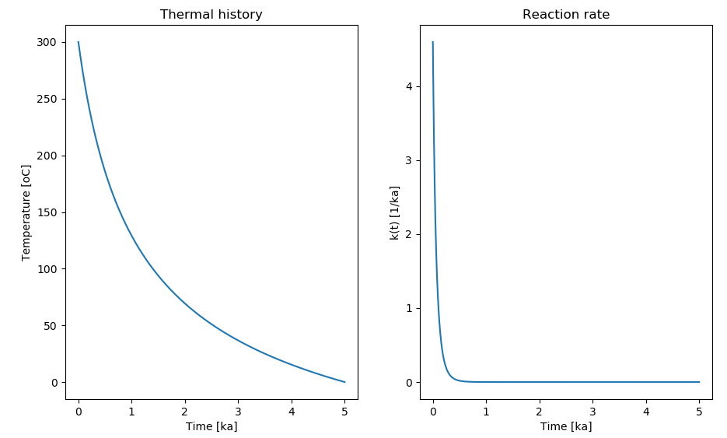
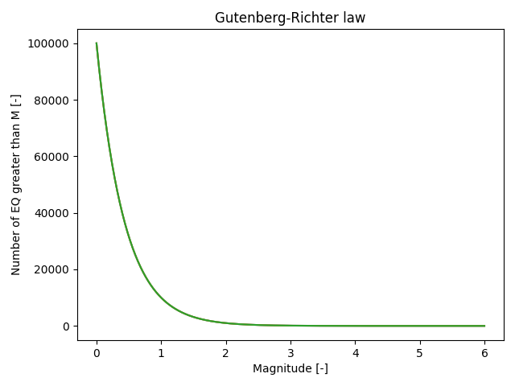
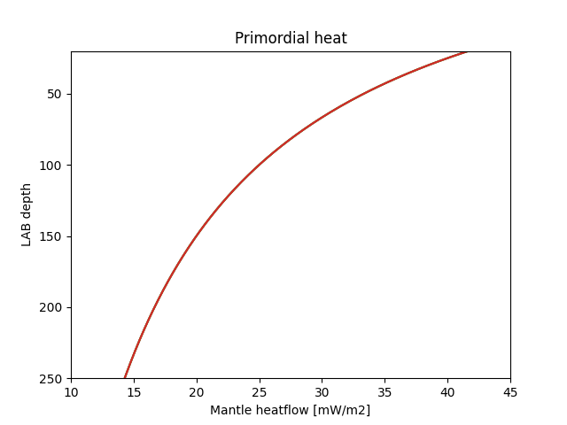
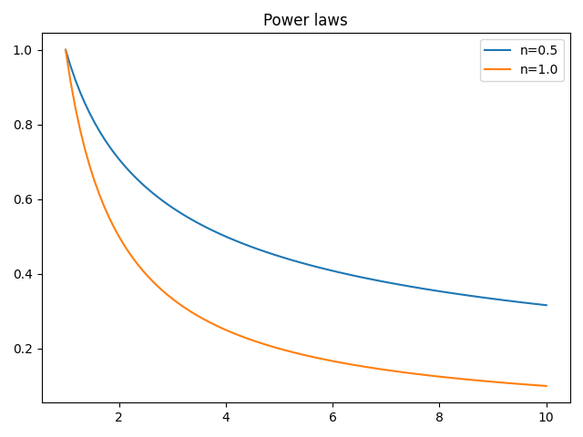
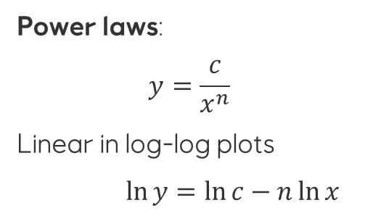
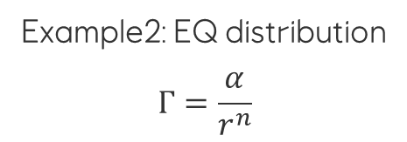
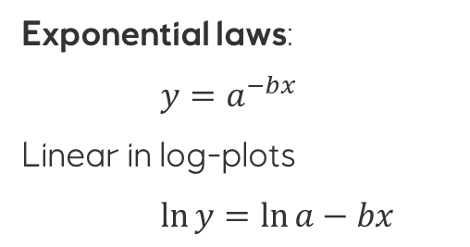
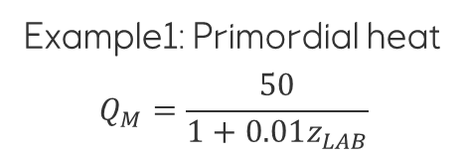
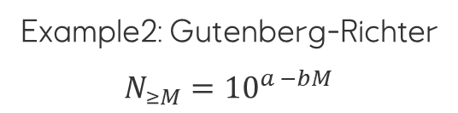
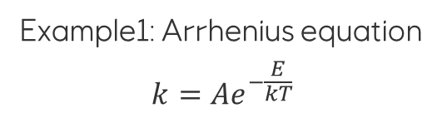
Exponential laws and power laws are common in nature
Exponential laws:
$y=a^{−bx}$
Linear in log-plots
$\ln{y}=\ln{a}−bx$
Example1: Arrhenius equation
$$k={Ae}^{−\frac{E}{kT}}$$
Example2: Gutenberg-Richter
$$N_{≥M}={10}^{a −bM}$$
Power laws:
$$y=\frac{c}{x^{n}}$$
Linear in log-log plots
$\ln{y}=\ln{c}−n\ln{x}$
Example1: Primordial heat
$$Q_{M}=\frac{50}{1+0.01z_{LAB}}$$
Example2: EQ distribution
$$Γ=\frac{α}{r^{n}}$$

Slide 4
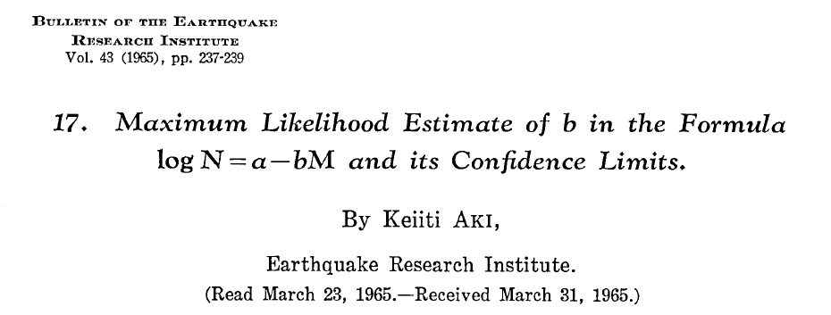
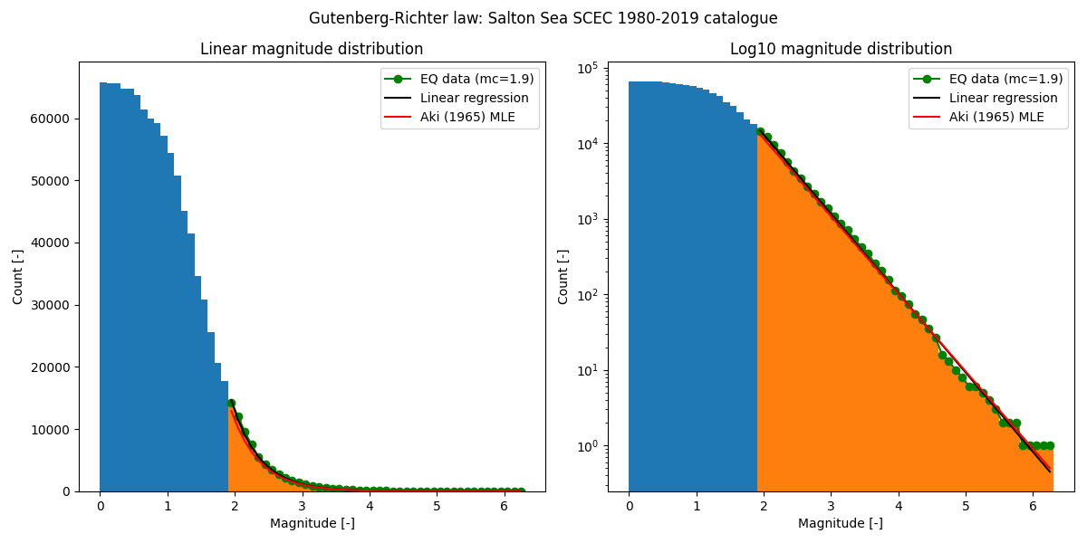
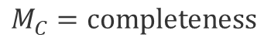
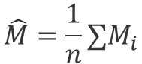
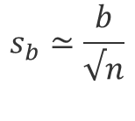
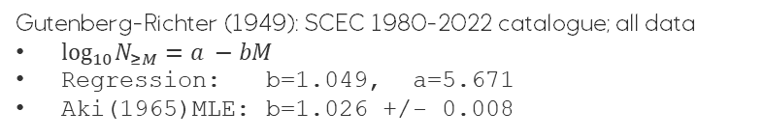
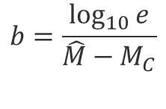
Estimation of b-values
Shallow cluster: Earth quakes in sediments and metasediments
Large earthquakes (M>5) occur mainly in the deeper cluster
Deeper cluster: Earth quakes in the crust
$$N_{≥M}={10}^{a −bM}$$
$$log_{10}N_{≥M}=a −bM$$
$$b=\frac{\log_{10}{e}}{\hat{M}−M_{C}}$$
$$\hat{M}=\frac{1}{n}∑M_{i}$$
$$M_{C}=completeness$$
$$s_{b}≃\frac{b}{√n}$$
Gutenberg-Richter (1949): SCEC 1980-2022 catalogue; all data
$log_{10}N_{≥M}=a −bM$
Regression: b=1.049, a=5.671
Aki(1965)MLE: b=1.026 +/- 0.008

Slide 5
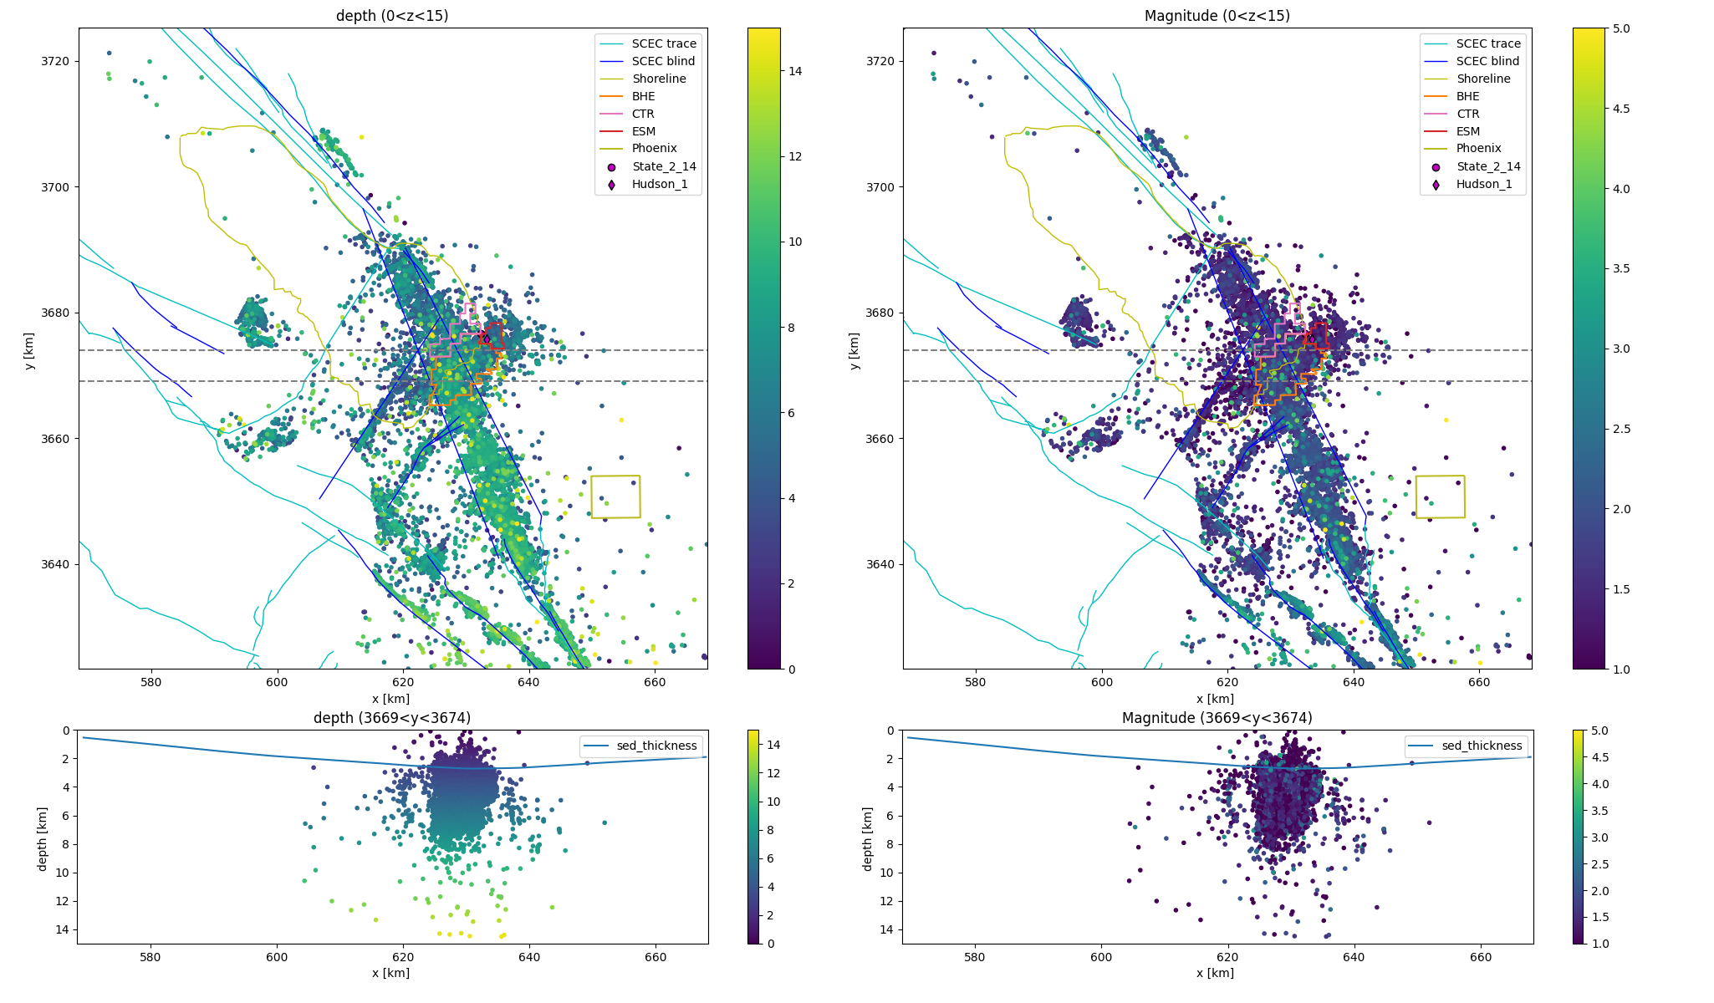
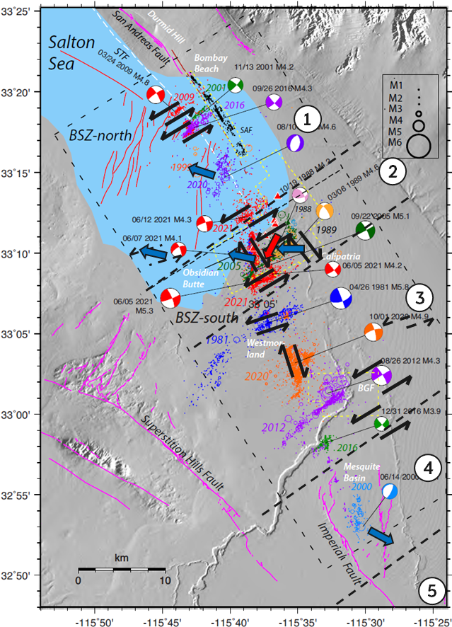
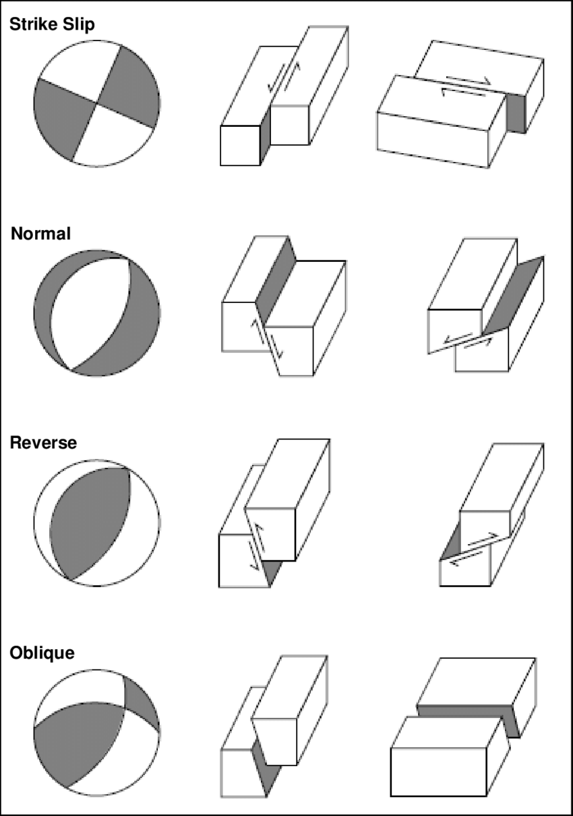
Adapted from Hauksson et al (2022)
Seismicity in and below sedimentary package

Slide 6
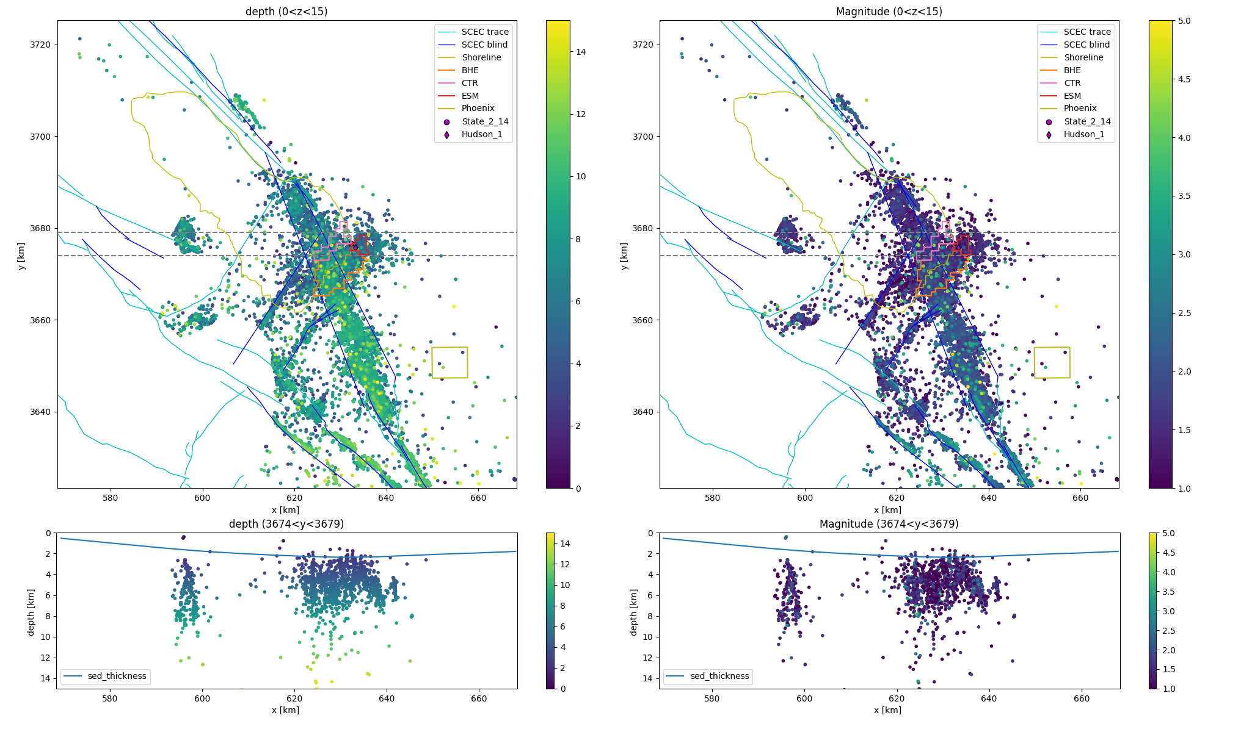
Adapted from Hauksson et al (2022)
Seismicity mainly below sedimentary package

Slide 7
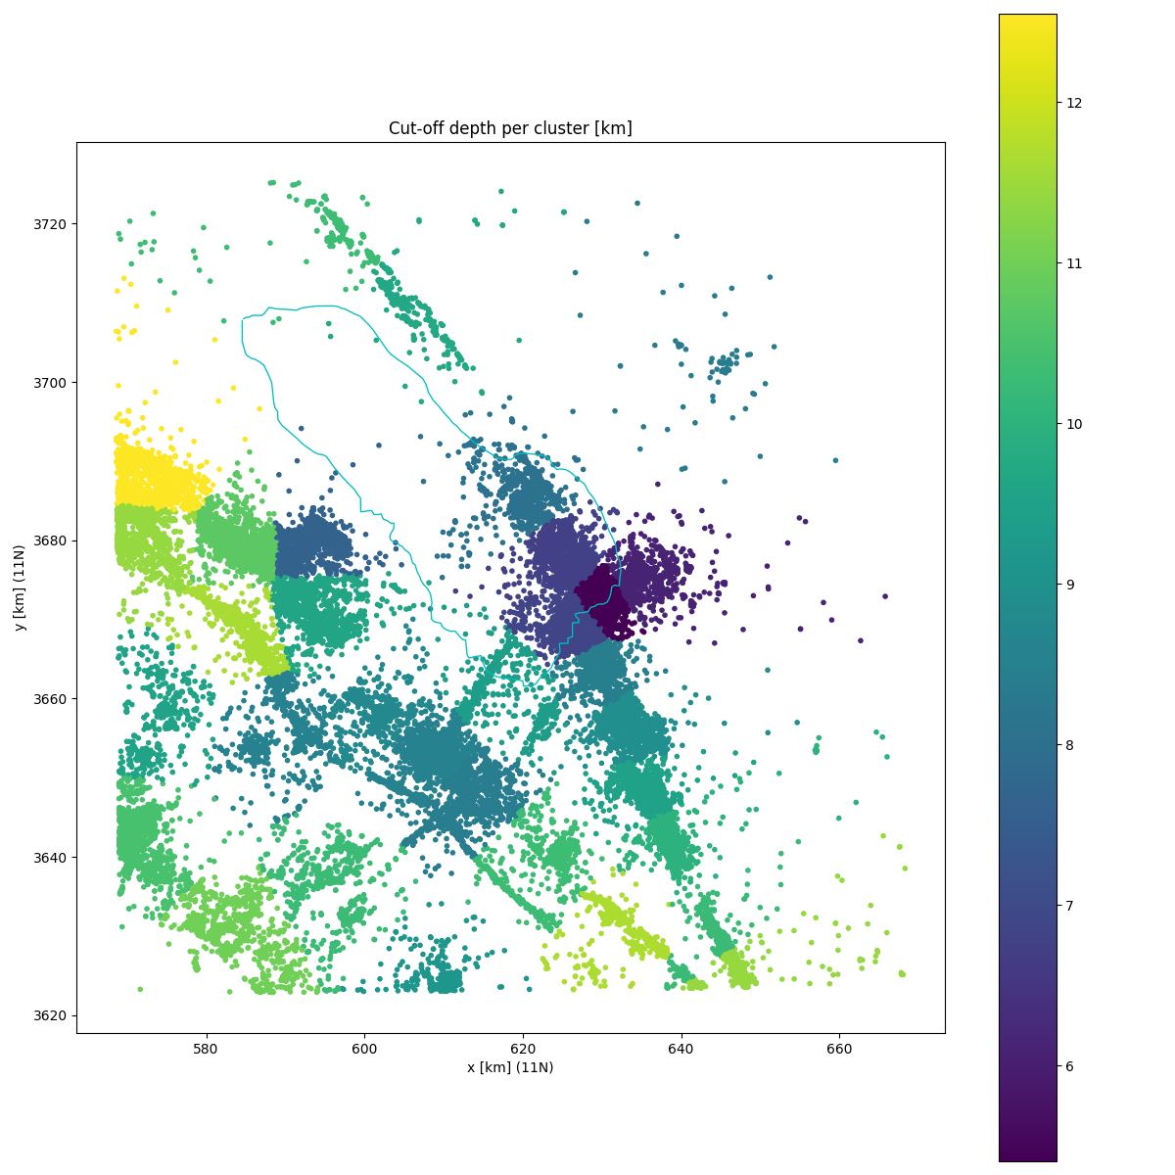
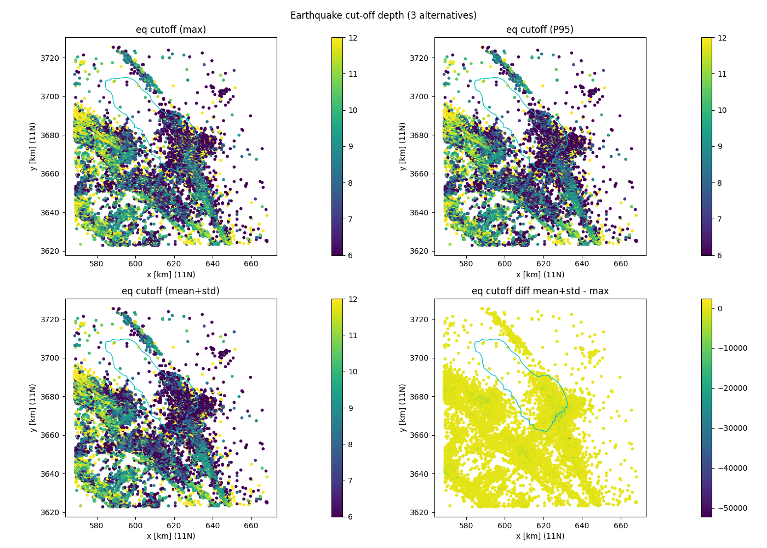
Earthquake cut-off depth

Slide 8
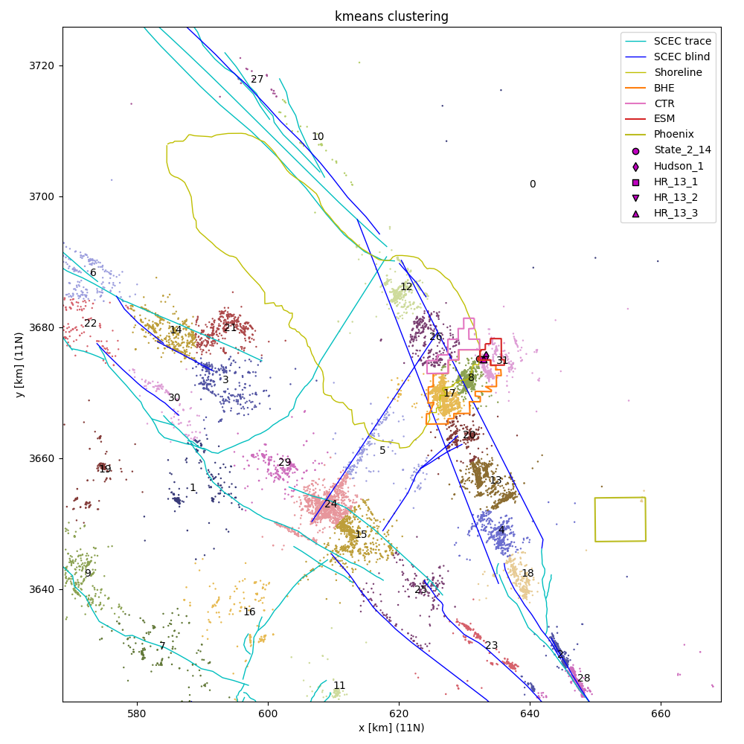
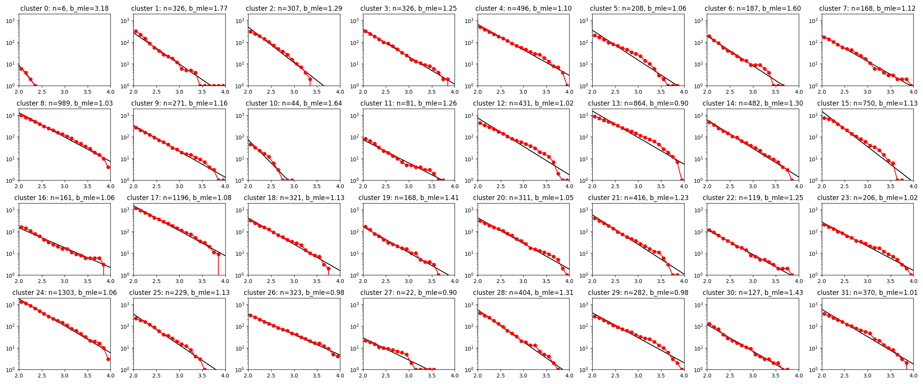
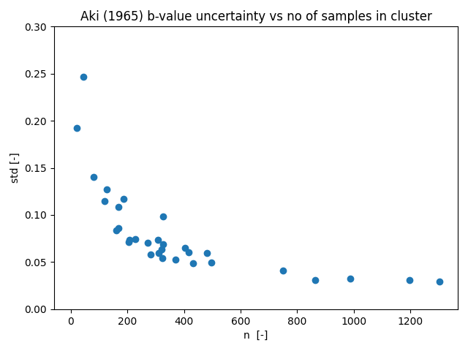
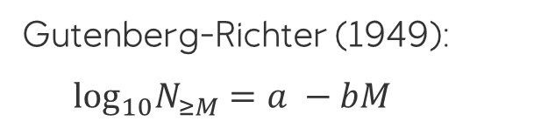
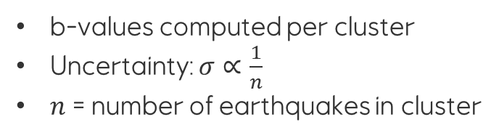
b-values per cluster
Gutenberg-Richter (1949):
$log_{10}N_{≥M}=a −bM$
b-values computed per cluster
Uncertainty: $σ∝\frac{1}{n}$
$n$ = number of earthquakes in cluster

Slide 9
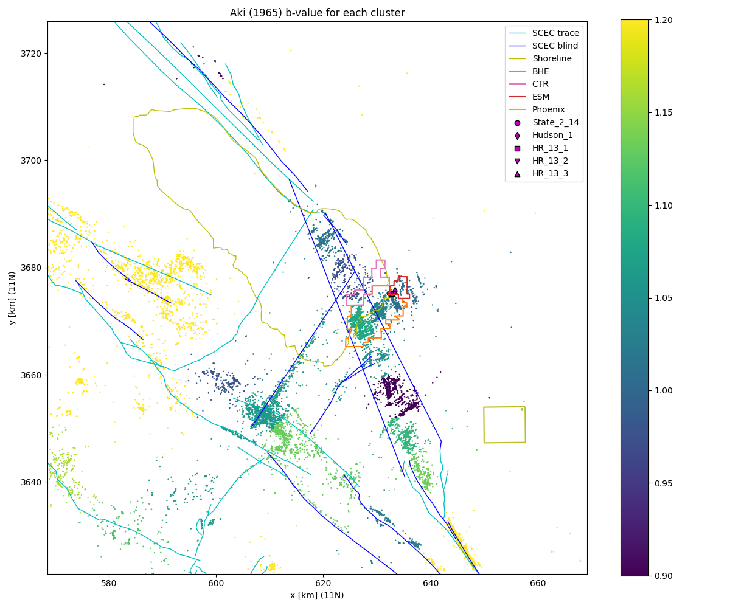
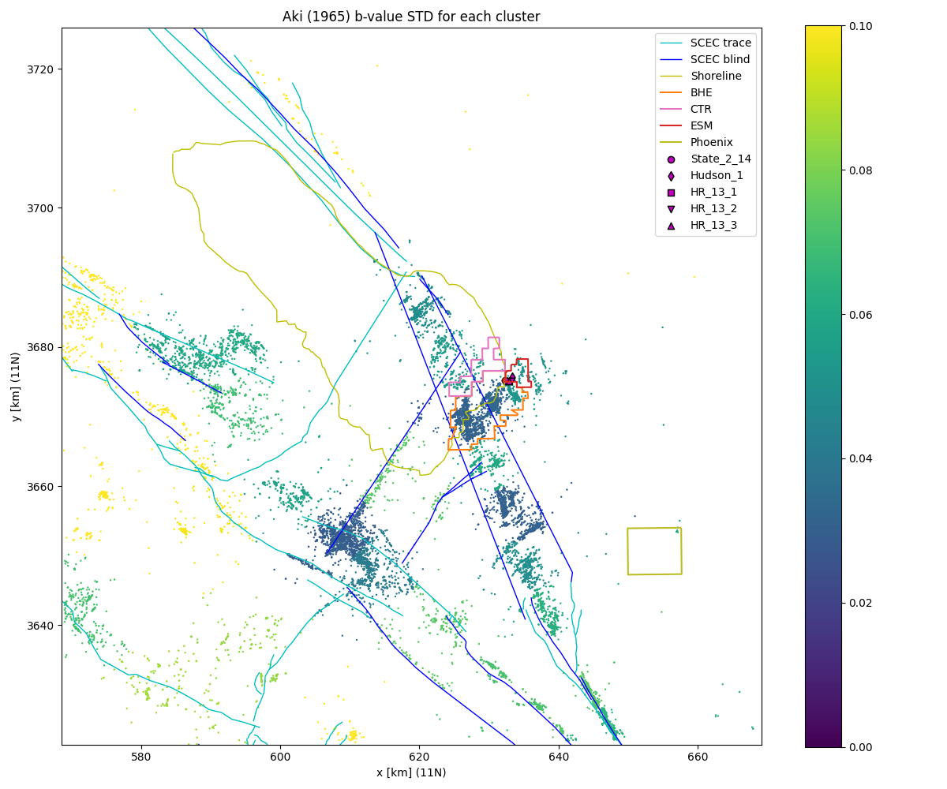
b-values per cluster (MLE method; Aki, 1965)
Gutenberg-Richter (1949):
$log_{10}N_{≥M}=a −bM$
b-values computed per cluster
Uncertainty: $σ∝\frac{1}{n}$
$n$ = number of earthquakes in cluster

Slide 10
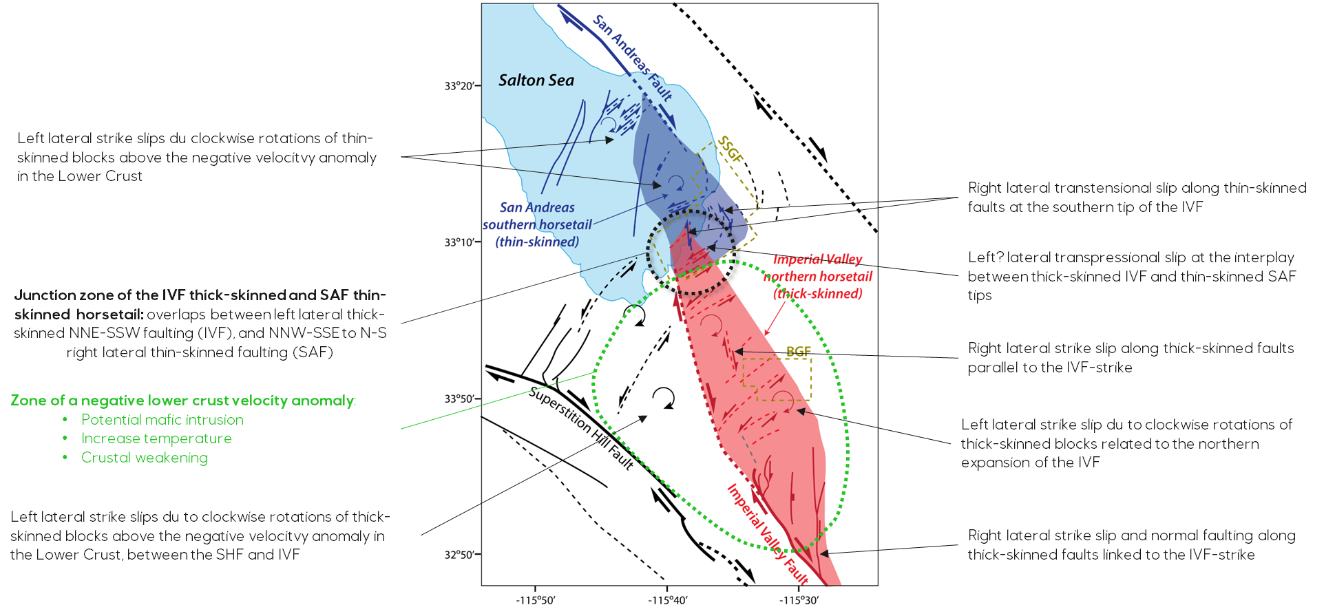
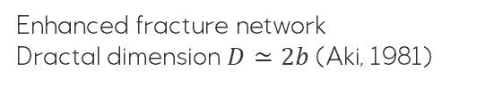
b-values (per cluster)
Gregoire’s interpretation
Adapted from Hauksson et al (2022) by Gregoire
Possible causes of elevated b-values:
Natural seismicity from tectonics
Induced seismicity from geothermal activity
Magma chamber below (ductile rock => high b-value)
Enhanced fracture network
Dractal dimension $D≃2b$ (Aki, 1981)

Slide 11
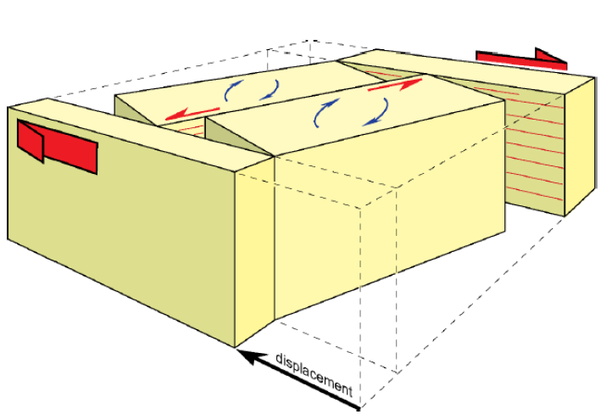
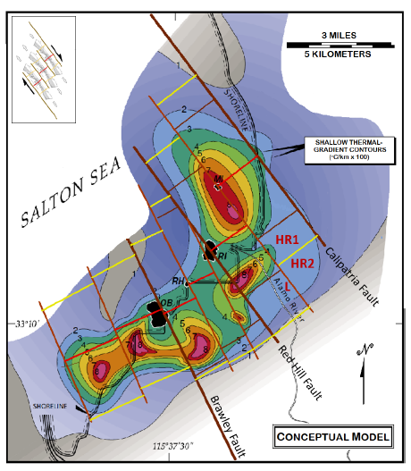
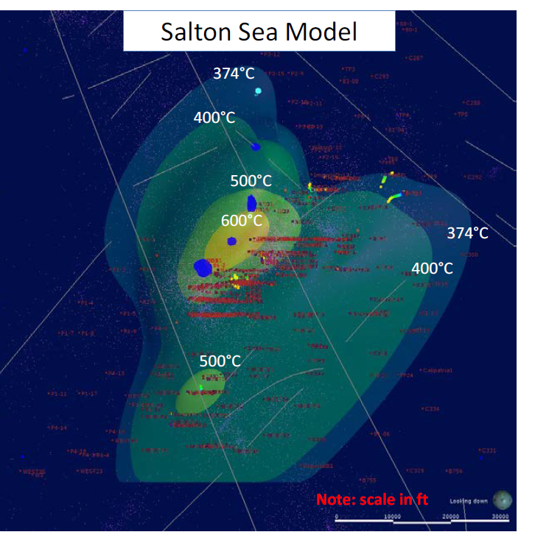
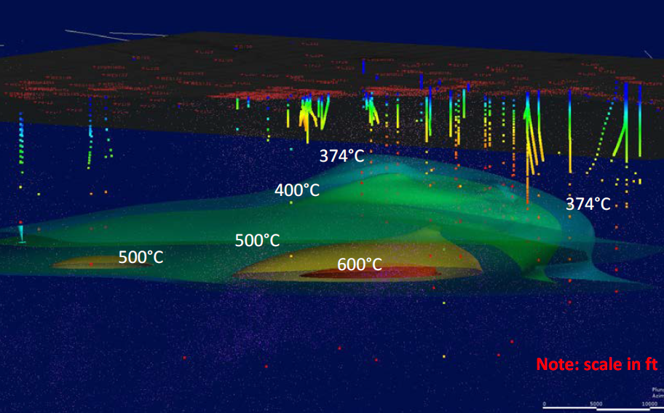
Temperature model and shallow gradients
Stimic et al. (2017)
Thermal model focused on supercritical resouces
Kaspereit et al (2016)
Hulen et al (2002)
Newmark et al. (1988)

Slide 12
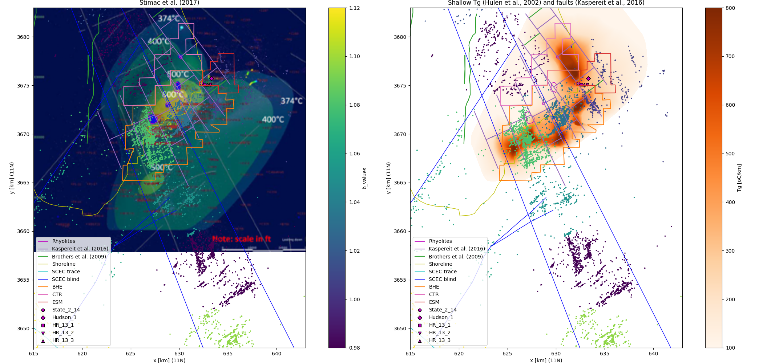
Heat sources and b-values

Slide 13
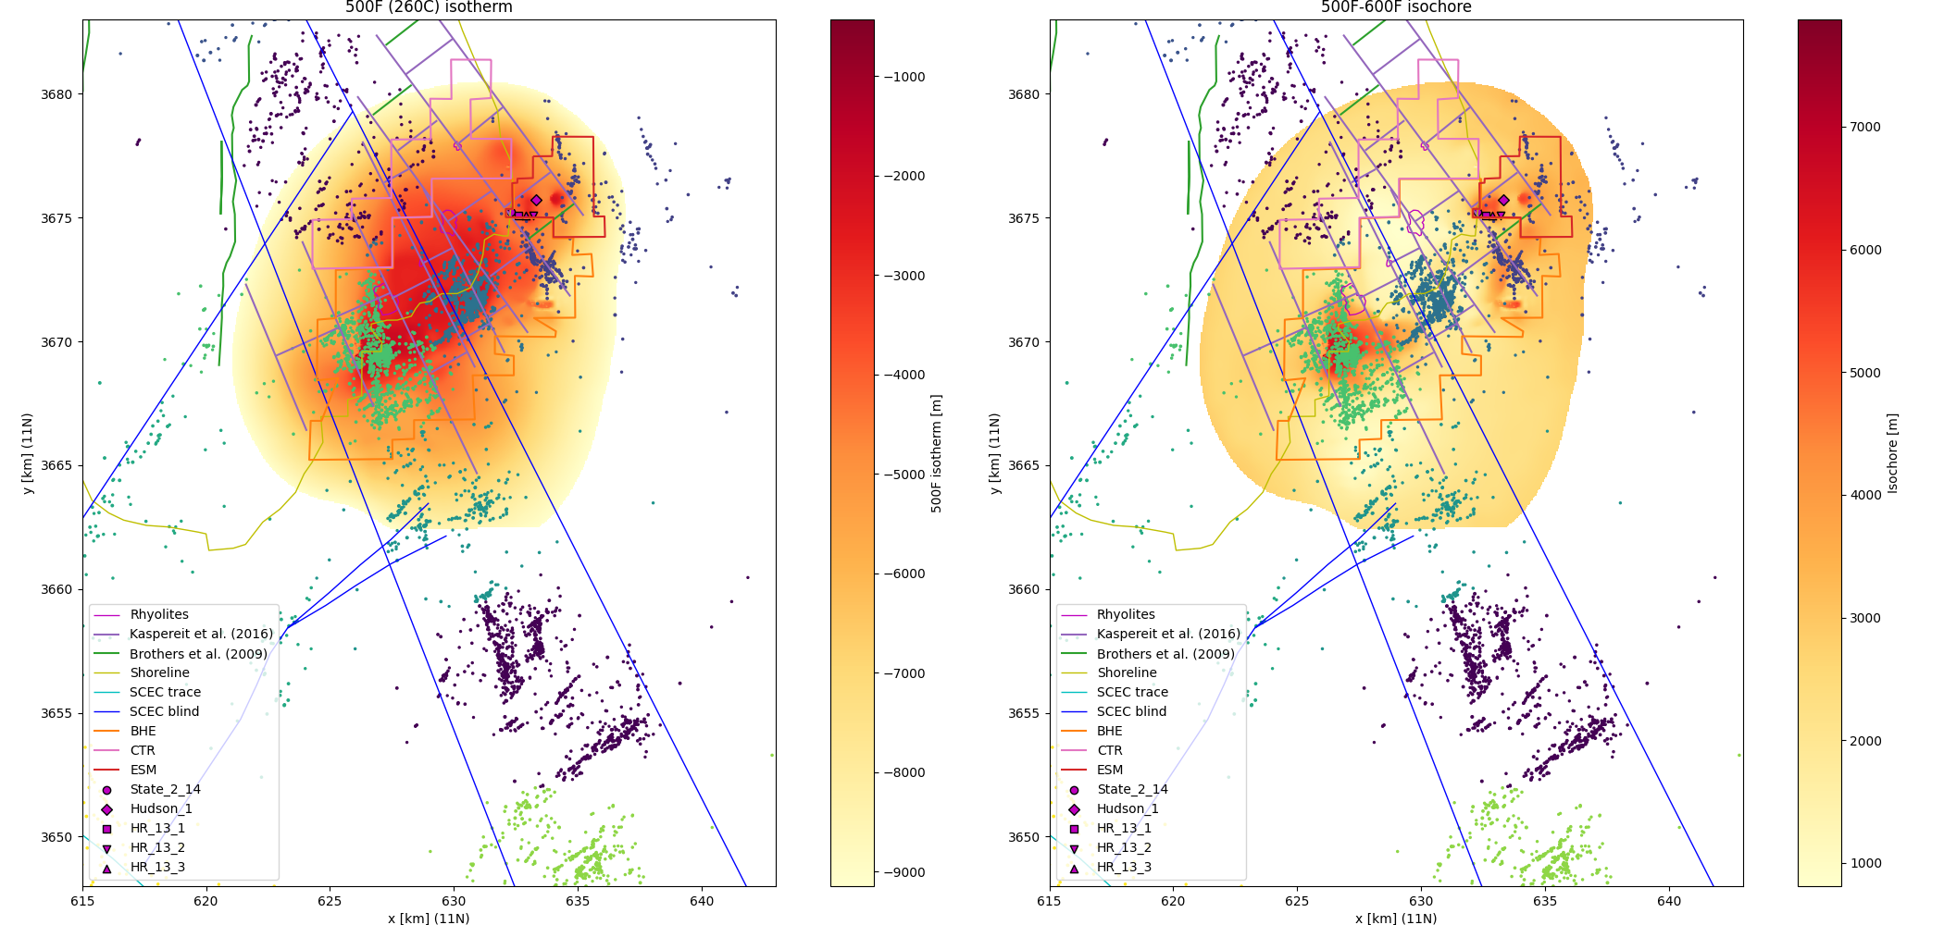
Heat sources and earthquake cut-off depth

Slide 14
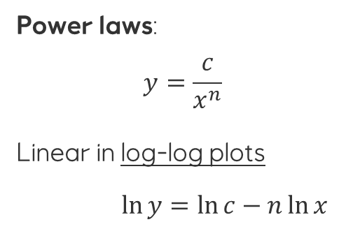
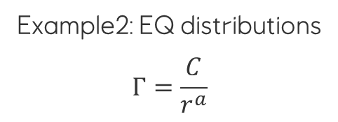
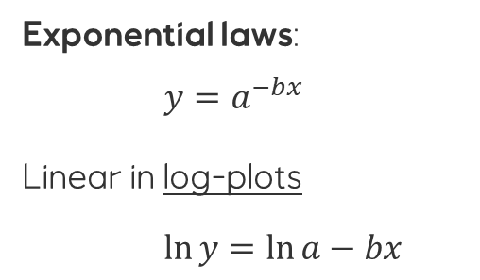

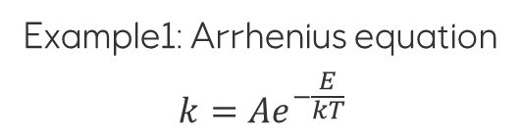
Exponential laws and power laws are common in nature
Exponential laws:
$y=a^{−bx}$
Linear in log-plots
$\ln{y}=\ln{a}−bx$
Example1: Arrhenius equation
$$k={Ae}^{−\frac{E}{kT}}$$
Example2: Gutenberg-Richter
$$N_{≥M}={10}^{a −bM}$$
Power laws:
$$y=\frac{c}{x^{n}}$$
Linear in log-log plots
$\ln{y}=\ln{c}−n\ln{x}$
Example1: Primordial heat
$$Q_{M}=\frac{50}{1+0.01z_{LAB}}$$
Example2: EQ distributions
$$Γ=\frac{C}{r^{a}}$$

Slide 15
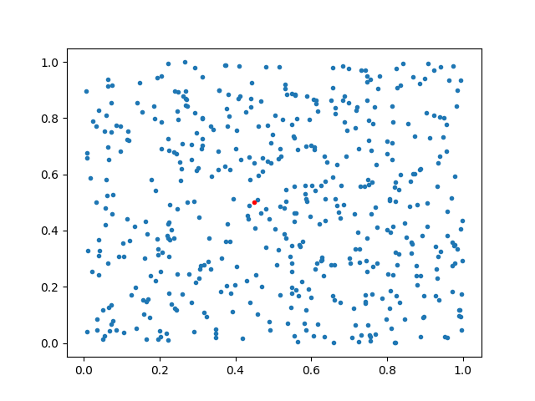
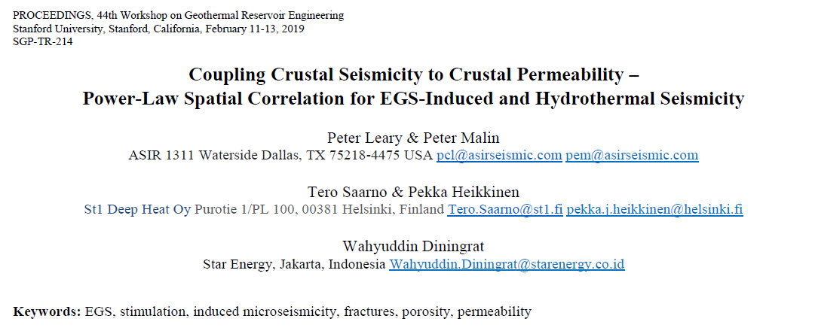








Two-point correlation
Count events between $r$ and $r+Δr$
Normalize by $ΔA=2πrΔr$
Porosity:
2-point correlation: $Γ\left(r\right)∼\frac{1}{r^{a}}$
Co-variance: $Σ_{φ}=σ_{φ}^{2}Γ\left(r\right)$
pdf: $p\left(φ\right)∝e^{{−\frac{1}{2}\left[φ−μ_{φ}\right]}^{T}Σ_{φ}^{−1}\left[φ−μ_{φ}\right]}$
$$φ={\left[\begin{matrix}φ\left(x_{1}\right) & … & φ\left(x_{n}\right)\end{matrix}\right]}^{ T}$$
Permeability:
$$\ln{k\left(x_{i}\right)=αφ\left(x_{i}\right)+β}$$

Slide 16



Two-point correlation
Power law correlation:
$Γ\left(r\right)∼\frac{1}{r^{a}}$
$a∼\frac{1}{2}$
Wavenumber domain
$Γ\left(k\right)∼\frac{1}{k^{b}}$
$b∼1$
x-domain
k-domain
$λ∝\frac{1}{k}$

Slide 17


Clustering, two-point correlations
x-domain
k-domain
$λ∝\frac{1}{k}$

Slide 18



Clusters in clusters in clusters …
Level 1 clusters
All data
Level 1 clustering
(cluster 8, 17, 31)
Level 2 clustering
(cluster 0, 1)
Level 2 clusters

Slide 19




Sampling the porosity distribution: $a=1.0$
Correlation and covariance
Some distributions and correlations

Slide 20




Sampling the porosity distribution: $a=0.5$
Correlation and covariance
Some distributions and correlations

Slide 21




Permeability models
$$a=0.5$$
$$a=1.0$$

Slide 22


Focal mechanisms Strike, dip, rake and beachballs

Slide 23


Fault dip = 45 deg
Fault dip = 90 deg
Strike slip (left lat)
rake = 0 deg
Strike slip (right lat)
rake = 180 deg
Normal fault
rake = -90 deg
Thrust fault
rake = +90 deg
Beachballs in Python:
obspy.imaging.beachball

Slide 24
rpgen function (Kwiatek and Ben-Zion, 2013) - Matlab ported to Python
First motion magnitude depending on
Fault strike and dip
Rake angle (and tensile angle)
Ray azimuth and take-off (grazing) angles
P and S body waves
References:
Ou, G.-B., (2008), Seismological Studies for Tensile Faults. Terrestrial, Atmospheric and Oceanic Sciences 19, 463.
Kwiatek, G. and Y. Ben-Zion (2013), Assessment of P and S wave energy radiated from very small shear-tensile seismic events in a deep South African mine. J. Geophys. Res. 118, 3630-3641
Kwiatek’s Matlab code is public on the Internet
Ported to Python
Gp = cos(TKO)*(cos(TKO)*(sin(gamma)*(2*cos(dip)**2 - (2*sigma)/(2*sigma - 1)) + \
sin(2*dip)*cos(gamma)*sin(rake)) - \
cos(AZM)*sin(TKO)*(cos(gamma)*(cos(2*dip)*sin(rake)*sin(strike) + \
cos(dip)*cos(rake)*cos(strike)) - sin(2*dip)*sin(gamma)*sin(strike)) + \
sin(AZM)*sin(TKO)*(cos(gamma)*(cos(2*dip)*cos(strike)*sin(rake) - \
cos(dip)*cos(rake)*sin(strike)) - sin(2*dip)*cos(strike)*sin(gamma))) + \
sin(AZM)*sin(TKO)*(cos(TKO)*(cos(gamma)*(cos(2*dip)*cos(strike)*sin(rake) - \
cos(dip)*cos(rake)*sin(strike)) - sin(2*dip)*cos(strike)*sin(gamma)) + \
cos(AZM)*sin(TKO)*(cos(gamma)*(cos(2*strike)*cos(rake)*sin(dip) + \
(sin(2*dip)*sin(2*strike)*sin(rake))/2) - sin(2*strike)*sin(dip)**2*sin(gamma)) + \
sin(AZM)*sin(TKO)*(cos(gamma)*(sin(2*strike)*cos(rake)*sin(dip) - \
sin(2*dip)*cos(strike)**2*sin(rake)) - sin(gamma)*((2*sigma)/(2*sigma - 1) - \
2*cos(strike)**2*sin(dip)**2))) - \
cos(AZM)*sin(TKO)*(cos(TKO)*(cos(gamma)*(cos(2*dip)*sin(rake)*sin(strike) + \
cos(dip)*cos(rake)*cos(strike)) - sin(2*dip)*sin(gamma)*sin(strike)) - \
sin(AZM)*sin(TKO)*(cos(gamma)*(cos(2*strike)*cos(rake)*sin(dip) + \
(sin(2*dip)*sin(2*strike)*sin(rake))/2) - sin(2*strike)*sin(dip)**2*sin(gamma)) + \
cos(AZM)*sin(TKO)*(cos(gamma)*(sin(2*dip)*sin(rake)*sin(strike)**2 + \
sin(2*strike)*cos(rake)*sin(dip)) + sin(gamma)*((2*sigma)/(2*sigma - 1) - \
2*sin(dip)**2*sin(strike)**2)))

Slide 25

rpgen function (Kwiatek and Ben-Zion, 2013): Matlab ported to Python
First motion magnitude depending on
Fault strike and dip
Rake angle (and tensile angle)
Ray azimuth and take-off (grazing) angles
P and S body waves
References:
Ou, G.-B., (2008), Seismological Studies for Tensile Faults. Terrestrial, Atmospheric and Oceanic Sciences 19, 463.
Kwiatek, G. and Y. Ben-Zion (2013), Assessment of P and S wave energy radiated from very small shear-tensile seismic events in a deep South African mine. J. Geophys. Res. 118, 3630-3641
Kwiatek’s Matlab code is public on the Internet
Pure shear slip
Pure tensile slip

Slide 26



Fun fact: Earthquake source mechanism can be used to model piezo-electric transducers and viscoelastic waves in cores on centimeter scale
Hokstad, K., Sollie, R., and Nes, O.-M., 2000, Finite-difference modeling of Viscoelastic Wave Propagation in Core Samples, SEG Annual Meetg, Calgary

Slide 27



rpgen function (Kwiatek, 2013): Modeling fault dip = 45 deg
Fault dip = 45 deg

Slide 28




rpgen function (Kwiatek, 2013): Modeling fault dip = 60 deg
Fault dip = 60 deg

Slide 29



rpgen function (Kwiatek, 2013): Modeling fault dip = 90 deg
Fault dip = 90 deg

Slide 30







Seismic wave modes
Love-waves:
Transverse motion
Velocity gradient
P-waves:
Longitudinal motion
Reyleigh waves (ground roll):
Retrograde ellipic polarization
Scholte waves on fluid/solid interface
S-waves:
Transverse motion
Two isotropic modes: SV and SH
Head waves (refracted waves):
When $v_{P2} > v_{P1}$
2nd head wave if $v_{S2} > v_{P1}$
Geometrical spreading:
$$A∝\frac{1}{r^{1/2}}$$
Geometrical spreading:
$$A∝\frac{1}{r}$$
Geometrical spreading:
$$A∝\frac{1}{r^{3/2}}$$
In the current study, only P-wave polarity is utilized. No S-wave polarity available

Slide 31


Seismic wave modes: Data examples
OBS data with Scholte waves, head waves (refractions) and body waves (reflections)
Land data with Rayleigh waves (ground roll), head waves (refractions) and body waves (reflections)

Slide 32


1D velocity model for the Salton Sea from well data
Sclater and Christie (1982) compaction trend
$$φ(z)=φ_{0}e^{−γz}$$
Obeys the differential equation
$$\frac{dφ}{dz}=−γφ$$
Corresponding velocity trend:
$$v_{P}(z)={v_{∞}+(v}_{0}−v_{∞}) e^{−γz}$$
For the Salton Sea:
$v_{0}=2.199$ km/s
$v_{∞}=5.848$ km/s
$γ=0.392$/km

Slide 33





Ray tracing P-waves in a 1D exponential velocity trend model
Luckily, there is Wolfram Mathematica:
$$\frac{dx}{dz}=\frac{pv\left(z\right)}{\sqrt{1−{\left[pv\left(z\right)\right]}^{2}}}$$
$$p=\sin{\frac{θ}{v(z)}=}\cos{\frac{ψ}{v(z)}}$$
$θ=$ polar angle
$α={90}^{o}−θ=$grazing angle
$$θ$$
$$α$$
Rays (P-waves) are turning in the velocity gradient (ray-tracing using reciprocity)

Slide 34





Bayesian inversion for focal mechanisms Based on ideas published by Langet et al. (2020)
Bayesian inversion for strike, dip, rake
Posterior distribution
$p\left(φ, δ, λ | d\right)∝$ $p(d|φ, δ, λ;α, β)$ $p\left(φ, δ, λ\right)$
Forward model (goes into the likelihood)
$$d=sign\left(G_{P}\left(d|φ, δ, λ;α, β\right)\right)+n$$
$G_{P}$ given by Kwiatek and Ben-Zion (2013)
Angles:
posterior
likelihood
prior
$φ$ = strike
$δ$ = dip
$λ$ = rake
$α$ = ray take-off (grazing) angle
$β$ = ray azimuth angle

Slide 35



Data – selected earthquakes from SCEC (Hauksson, 2022)
Mainly surface waves (?)
Data used in inversion
Data from SCEC server:
Polarity of first P-wave motion (positive or negative)
Max offset used in inversion: 50 km
Events selected by Gregoire

Slide 36
Gregoire’s selection
Event IDs
9059316
9039664
9039606
10320761
11065613
15105052
15114473
15116089
15116121
15116321
11069757
15344513
15344585
15344465
15354321
15354537

Slide 37

Focal mechanisms estimated by Bayesian inversion
transform
normal
normal
trans-tension

Slide 38
Focal mechanisms estimated by Bayesian inversion
transform
normal
normal
trans-tension
Estimated strike, dip, rake angles

Slide 39

Focal mechanisms estimated by Bayesian inversion
Hypocenters not relocated

Slide 40

Focal mechanisms estimated by Bayesian inversion
Meged with relocated hypocenters from Hauksson (2022)

Slide 41

Data fit: Observed (red) vs forward modeled (colored) data

Slide 42






Some examples of marginal distributions for strike, dip, rake
Some sets of P-arrival picks gives multimodal or wide distributions

